Slide 1
COMP1003
Lab 01 Digital
Goliath

Slide 2
Lab Arrangement
Each lab takes 1 hour every week.
Each lab contains examples and exercises.
If a student has any question about anything of this course, please feel free to ask in the lab hours.

Slide 3
Lab Arrangement
Each lab requires a submission on iSpace.
Testcases will be provided. Students can verify the correctness by themselves. So, the submissions will not be marked.
Marks will be given, if we see submissions on iSpace. Yes, even if the submission is an empty file.
If you cheat, you cheat yourself.
But! Exams will cover the labs, you have to study eventually.

Slide 4
Lab Arrangement
Students have their freedom to decide to study every week or work hard before exams.
Even the second option usually does not end well.
We are very happy to see students are punished by cheating themselves. 😏
The teacher’s trouble is “too many good students are looking for A’s”, but not “too many bad students are failing the course”.

Slide 5
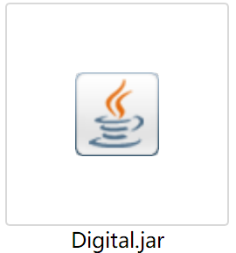
Digital
This course uses Digital for simulating circuit designs.
To get the simulator,
  Install a Java Runtime Environment (at least JRE 8).
  Download the Digital package from iSpace (or from Github).
  Start the JAR file.

Slide 6
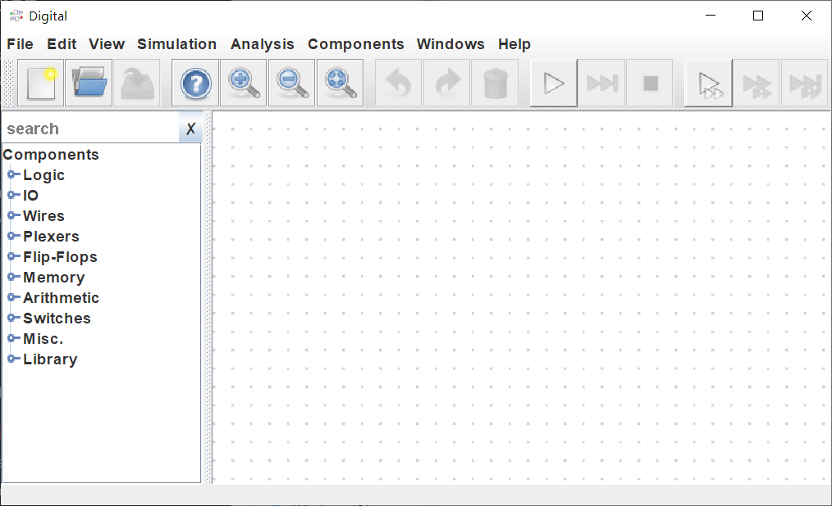
Digital
Control the circuit simulation
Component tree:
a list of all components,
displayed by “F5”
Workspace: circuit design implementation

Slide 7
Getting Start
An electronic computer is made by complex circuits.
A circuit is a combination of digital components and connections among them.
A component manipulates the signals (a representation of information).
A connection passes a signal from one component to others.

Slide 8
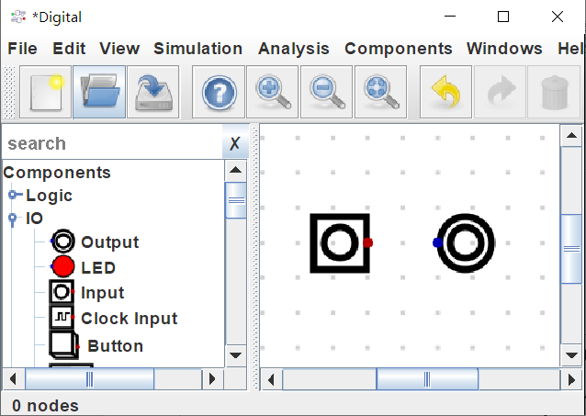
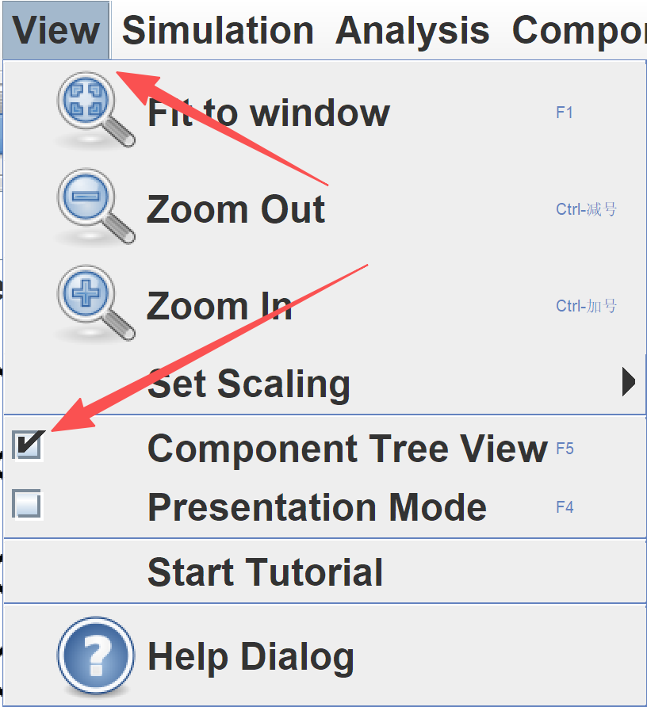

Example 1
Place an “Input” and an “Output” to the workspace.
You can find these components under “IO” category.
To show the component tree, “View” $→$ “Component tree view”

Slide 9

Example 1
“Input” component has a red dot to its right.
It is the position, where “Input” sends a signal to others.

Slide 10

Example 1
“Output” component has a blue dot to its left.
It is the position, where “Output” receives a signal from others.

Slide 11


Example 1
Connect “Input” to “Output” by
  Click the red dot of “Input”
  Click the blue dot of “Output”
Click to start a simulation.
In a simulation, the state of “Input” can be changed by clicking.
Observe the state of “Output”.
Click to stop the simulation.
This circuit is not exciting. The output is same as input.

Slide 12
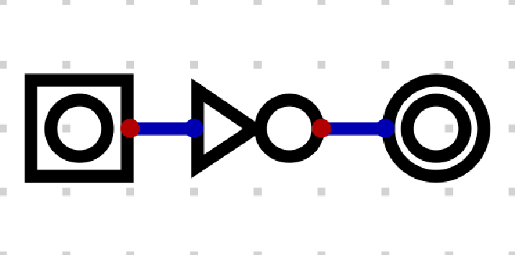
Example 2
Try to construct the following circuit and observe the output.
This circuit uses a gate to manipulate the signal.
More about gates will be introduced in following weeks.

Slide 13
Example 2
Here is a list of some basic operations in Digital.
  Mouse roller - zoom in/out
  Hold right mouse button - move the workspace
  Left mouse button - select a component or make a link
  “Shift” + LMB - select multiple components or links
  “Delete” / “Backspace” - remove the selected components
  Mouse drag - move the selected components

Slide 14
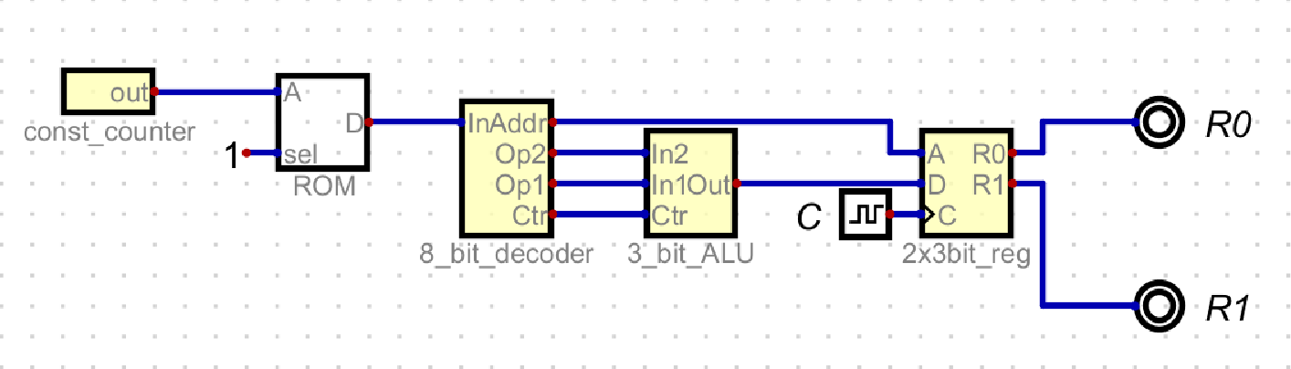
Example 3
Download and extract the package “lab01_material.zip”.
Open “W01_E3.dig” in Digital.
Reposition the components and connect them as follows.
Labels of the two “Output” are given by right-clicking. Also, set the data bits of “Output” to 3 bits.

Slide 15
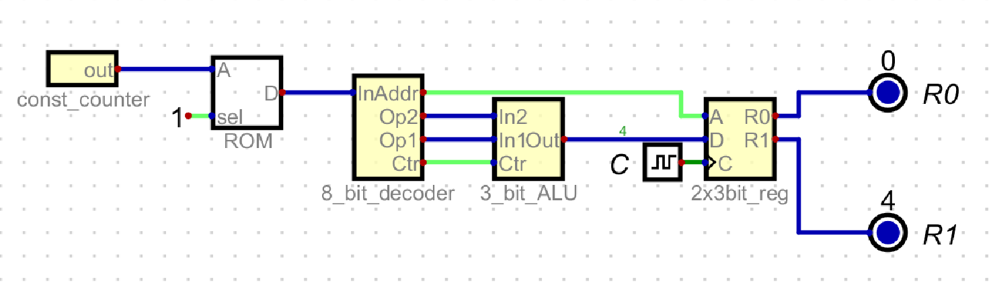
Example 3
If everything works normally, you should see the following figure when a simulation starts.
“0” is above “R0” and “4” is above “R1”.

Slide 16

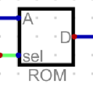
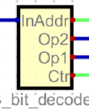
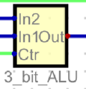

Example 3
This is a simple example of the von Neumann Architecture.
Recall the fetch-decode-execution cycle.
(counter) fetches one instruction from (memory).
(decoder) decodes the instruction.
(ALU) executes the operation on data.
And the result is stored in (register).

Slide 17
Example 3
Right click the memory and edit data.
You will see at address “0x0” the value is “0xE5”.
“0xE5” is a hexadecimal number. Its binary is
11100101
meaning that
  operation 1 is subtraction,
  110 (number 6 in decimal) is the first operand,
  010 (number 2 in decimal) is the second operand, and
  the result is stored at register 1.
That’s why you see “4” above “R1”.

Slide 18
Example 3
The ALU can do two operations.
  If the operation code is “0”, ALU does addition.
  If the operation code is “1”, ALU does subtraction.
The register has two locations.
Thus, write “0x44” at address “0x0” in the memory and observe the outcome.

Slide 19
Example 3
You should see “6” above “R0”.
This encoding is only designed for this example.
Different CPU architectures have different instruction sets.
Please don’t worry if you cannot understand the binary numbers, hexadecimal numbers, instruction codes, or the circuits. Details will be introduced in the following weeks.

Slide 20
Submission
Save the circuit for Example 3 as the name “lab01_sub.dig”.
Submit this file to iSpace.
No marks will be given if the file name is wrong.

Slide 21
End of Lab 01

